Slide 1

Advance Care Planning
A Brief Introduction
Helen Rigby – 3DHB Advance Care Planning Project Manager
Helen.Rigby@sidu.org.nz

Slide 2



Planning – we love it!!
https://www.youtube.com/watch?v=RlauUxwFqkI

Slide 3
Scope of advance care planning
ADVANCE CARE PLANNING CONVERSATIONS (context)
ADVANCE CARE PLAN
ADVANCE DIRECTIVE
Diagram from the National ACP Cooperative
Notes:
ACP is a process of discussion & shared planning. ACP would rarely be a one off conversation. Ideally it is a series of conversations with whanau and with health providers over time as a person’s health changes. It is a unique form of planning in that it is planning for a time in the future when we may not be able to express our own decisions.
From a consumer viewpoint:
Opportunity to develop and express their preferences for future & end of life care based on:
their personal views and values
a better understanding of their current and likely future health
the treatment and care options available.
From a clinician viewpoint:
Dr Barry Snow – Clinical Lead ACP National Cooperative
“It is about letting the patient know exactly what’s going on; Asking for their opinions; Making sure they’ve got a say in their care
...so exactly what we should be doing with good medical care”
The conversation will change and evolve as a person’s condition evolves. What we might think we want in the future now, while we are well, might change if we are really sick. So it is a dynamic process and a continuing conversation. Starting the conversation now while you are well will make hard decisions during a medical crisis much easier.
As a society we are not good at talking about dying & EoL (& not isolated to NZ). With the development of modern treatments and medical techniques, death has been come to be viewed as a failure even though it is a natural and sadly inevitable reality for all of us. We are much more comfortable as health care professionals to talk about what CAN be offered to treat conditions than acknowledge that treatment is no longer helpful or curative.
ACP is partly about aligning preferred care with the care provided. The only way that this can be done is with patient engagement. Helping people understand what lies ahead and understanding what their preferences might be and /or the degree that they want to be involved in the decision making.
These conversations are often really difficult and rely on skilled communication. Good ACP requires clinicians to have honest and courageous conversations with their patients so that they are ‘on the same page’.
Characteristics of a “Just Right” Advance Care Planning Discussionfrom Strategic Targeting of Advance Care Planning Interventions: The Goldilocks Phenomenon
J. Andrew Billings, MD; Rachelle Bernacki, MD3 JAMA 2014
Patients understand their medical condition—their diagnosis, prognosis, and clinical options—and are aware of the trade-offs involved in any choices to undergo or forego potentially life-prolonging therapies
Patients’ values, goals, and preferences are elicited and later used to make choices about specific methods of life-sustaining care
When appropriate, an involved clinician makes a recommendation, based on patients’ values, goals, and preferences
Decisions are be made with adequate time for reflection, discussion with family, and further consultation
Decisions are carefully documented, conveyed to the family, and made available to other health care practitioners.
As the medical situation changes, especially on hospital admission or institutional transfer, choices are revisited.
Initiating ACP well before patients are facing end-of-life decisions may serve the function of introducing the conversation and opening communication about these matters with the family, health care agent, and clinical team.
From ACP: Not a panacea Palliative Medicine 2016. Vol30(5) 421-422
Potentially effective elements of ACP:
People’s raised awareness that they have options to choose from
Having a targeted and structured conversation about preferences for future care
The documentation of such preferences
The mere fact that patients, relatives and health care professionals communicate OR the patients’ knowledge that their relatives know their preferences and will act on their behalf
AD
Does not need to be in writing
Only applies when patient unable to communicate
Cannot require the provision of specific treatment
REQUIREMENTS for VALIDITY:
Patient must be competent
Informed
Free of undue influence
AD must have been intended to apply in the circumstances that have arisen

Slide 4
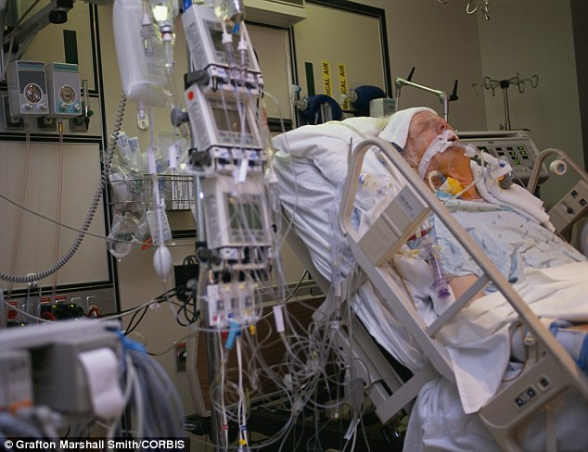
Why is advance care planning important?
Notes:
Most of us want a gentle and peaceful death
Most of us (~ 85%) will die after chronic illness, not a sudden event
Up to half of us are not in a position to make our own decisions when we are near death
Our family have a significant chance of not knowing our views without discussion (if no overt discussion behind decisions an EPoA is making then likely to get it wrong 1/3-1/2 the time)
A doctor who is uncertain about what to do, and who has to make a decision, will often treat aggressively (particularly in an emergency or acute situation; default position tends to be CURATIVE)
Many of us will be kept alive under circumstances that are not dignified, frequently suffering and in a way that we would not have wanted
Recent publication:
Non-beneficial treatments in hospital at the end of life: a systematic review on extent of the problem
M CARDONA-MORRELL et al International Journal for Quality in Health Care Advance Access (June 27, 2016)
Article looked at variety and extent of NBT provided in the last 6 months of life. Concluded, from the literature examined, that at least 1/3 of people were receiving NBT in their final months.
Focus was on aggressive active management beyond comfort care in the last 6 months of life when the clinical presentation should have signalled the time for transition from aggressive to palliative or comfort care. Results confirmed a culture of ‘doing everything possible’ even if it was against expressed patients’ wishes.
These behaviours have repercussions not only on the capacity and financial sustainability of the health services, and perpetuate the unrealistic high social expectation of survival at all costs, but also more importantly reflect a disregard for human dignity and quality end of life.
We know from research that people who had substantive discussions with their doctor about end of life preferences and options were far more likely to die in peace and in control of their situation. We also know that the bereavement process is easier for those left behind if they had been part of these conversations and the planning.
With the advent of modern medicine and medical advancement, we have become a death defying community. We know that one of the barriers for discussions about ACP may be that practitioners feel that they are taking away hope. If framed correctly ACP will help the person to live well and to know what to expect as their health changes.

Slide 5


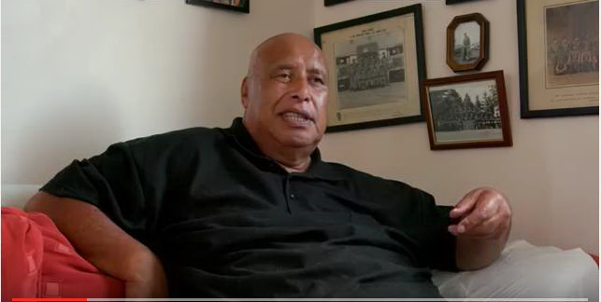
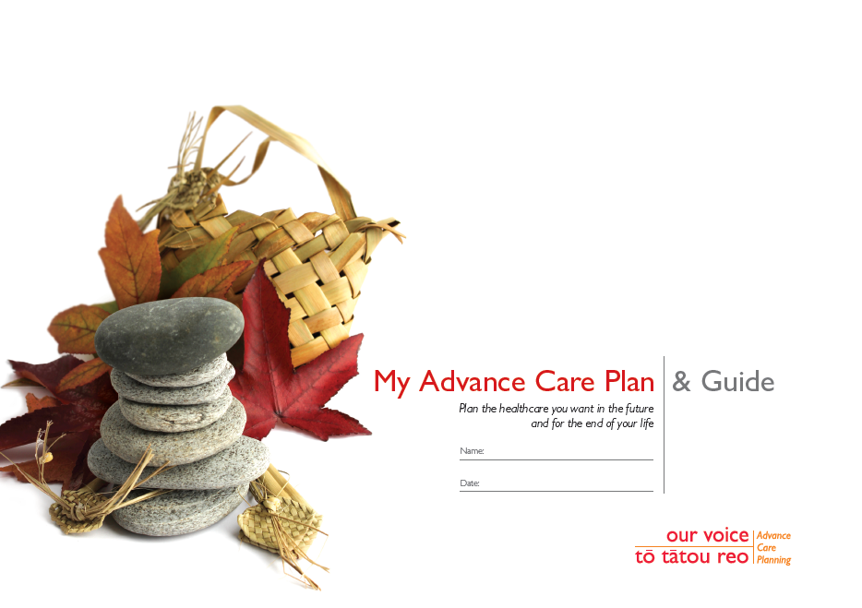
Advance Care Planning in NZ
http://www.hqsc.govt.nz/news-and-events/news/2646/
Notes:
At a national level the National Advance Care Planning Cooperative (based in Auckland DHB) provide the ACP training and have lead ACP resource development and other ACP initiatives. There is an ACP Roundtable with representation from each of the 4 DHB regions including 2 Central region reps.
ACP National Cooperative are funded this financial year by the DHBs and HQSC are taking more of a clinical governance role of ACP and working in partnership with the National ACP Cooperative. Key deliverables for the DHB funding being provided for ACP this year include:
ACP training courses in each DHB (number depends on size of DHB)
management of the national ACP programme, including governance, policy development, promotion, consumer engagement, and resource development
delivery of ACP training courses in each DHB (number depends on size of DHB)
a training support function - working with DHBs to help them implement ACP
developing a five-year strategic plan for ACP – an ACP Advisory Group is being formed and will be tasked with this work
undertaking a review of the ACP approach in New Zealand, and future training needs
preparing a paper for DHB CEOs on the future direction and funding needs for ACP, for the 2017/18 year and ongoing.
HQSC have provided a print run of the new ACP Guide & Plan. We have received these in the 3DHBs (from HQSC) and are distributing upon request via Regional Public Health. To date there have been 42 requests and 860 plans distributed.
Promoting ACP through patient safety week – just released a video of Arthur – we may be getting Arthur coming to Wellington.
“Arthur Te Anini is on a mission. The 67-year-old South Aucklander wants to convince his fellow Māori to start talking about future health care and end of life care.”
New ACP Guide & Plan available - to date (since Sept 2016 – 42 requests from CCDHB and 860 distributed).

Slide 6
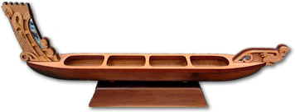
ACP – Maori Model
He Waka Kakarauri
Notes:
Northland District Health Board has taken the lead in developing culturally appropriate resources so health workers can talk with Maori about death and dying.
Nursing director Margareth Broodkoorn says research shows discussions around advance care planning are different for Maori and non-Maori, Pacific peoples, migrants, and other groups.
A series of co-design hui and workshops bringing together clinicians, healthcare workers, whanau and consumers were held to develop the model.
He Waka Kakarauri encourages people to have conversations about their health, when they are well and when they are sick, dying or have died - that are tika (right), pono (true) and aroha (shared with love).
The conversations can be held at a time and in an environment that is culturally appropriate to Maori.
Northland DHB kaumatua Te Ihi Tito the model places the wairua spirituality back into health conversations.
The guide is self-explanatory for patients and their support people and as Northland DHB Whaea Bella Hutchinson notes “is the first model that I have seen in a long time that places the wairua (spirituality) back into health conversations, and for this we are eternally grateful."
These Māori ACP resources are available to download from the ACP website.

Slide 7
3DHB ACP Project – two tier approach
Tier 1 – Awareness level
SCOPE: All
Objective 1 – Increase general awareness of ACP with public and service providers
Tier 2 – Embedding level
SCOPE: Targeted practices and services
Objective 2 – Develop system infrastructure to support ACPs being developed, stored, coded and accessible
Objective 3 – Increase workforce capability to lead ACP discussions and completion

Slide 8
ACP Tier 1
Average c. 30 registrations/month
Regular ACP Comms
>90 ACP Champions
ACP Training courses in all DHBs
ACP Presentations & Promotional Stands
c. 75 hits/month on HealthPathways
Notes:
ACP Comms – emails, articles eg. Age Concern, ACP Snippets
>65 ACP Presentations to <1000 people– target for the year to reach 1200 people – to date over 1000 – just under half = public
ACP promotional stands – nearly 500 people

Slide 9
What is needed to embed ACP?
Strategic fit
Cultural change
Dedicated resource
Embed ACP in workflow
Amend ACP to local context
Pre-existing infrastructure
Senior leadership
Notes:
We know that workforce upskilling and training is needed and we also know that on its own this won’t embed ACP into a service or organisation – other elements are needed to support it.
Foundational elements needed – one of these in isolation won’t embed ACP. These are the elements identifed by Helen Mason’s (now CEO of BOP DHB) Harkness fellowship ACP project and they fit with the Central Regional ACP Framework and echo the findings in the literature. We also know from previous work in the sub-region that one element alone (eg. Training or eg. A guideline/policy) won’t bring about systemic change/embedding.
Strategic Fit: a strong commitment to patient and family centred care
Cultural Change: in the community and within health systems so that death is spoken of and not seen as a failure
Dedicated resources: including quality improvement resources and dedicated resources for the actual delivery of advance care planning
Embed ACP in Workflow: to ensure sustainability
Pre-existing infrastructure: e.g. the electronic medical record, physician education on communication skills, and standard approaches to change management
Senior Leadership: that provides active, engaged and visible leadership to help implement change
Amend ACP to the Local Context

Slide 10
ACP Tier 2
Masterton Medical (GP)
Hutt Older Persons & Rehab Service
Muritai Health Centre (GP)
Whitby Doctors (GP)
Paraparaumu Medical (GP)
CCDHB Respiratory Outpatients
Mary Potter Hospice

Slide 11
Where else is there interest & progress with ACP?
Wairarapa emergency department
Martinborough Medical
Khandallah Medical
Kenepuru inpatients
Newlands Medical Centre
Miramar Medical
Renal CCDHB
Dept of Corrections
WellHealth – NUCHs & PUCHs
OraToa
Karori Medical Centre
Notes:
This is to highlight a number of areas outside of the ACP tier 2 project that are interested in ACP and/or forwarding work in ACP.
GPs – Martinborough, Khandallah & Newlands have staff members attending the Level 1A ACP Course (25/6/16)
Wairarapa ED – are determining a way of including a question about ACP and EPoA in the admission triage process; where relevant a referral will also be triggered to social work for ACP discussions to those going on to have an inpatient stay.
Renal CCDHB – are considering how ACP can be incorporated more routinely into pathways for their patients and in particular those with end stage renal disease
WellHealth & OraToa Practices are beginning to engage with the Level 1 ACP eLearning and considering how ACP may fit with their practices
Dept of Corrections have ACP Champions and are considering how ACP fits for those nearing the end of life or with life limiting conditions who need plans in place. In particular it is relevant for those in Te Whare Manaakitanga - Special Treatment Unit at Rimutaka Prison

Slide 12
Where to start...
ACP eLearning http://www.advancecareplanning.org.nz/healthcare/ (or access via ConnectMe for CCDHB)
Conversations that Count Day 5 April
  Morning tea in your practice or team (watch an ACP video eg. Arthur)
  Start a conversation with a friend, family member, patient
Notes:
Conversations that Count Day is on 5 April 2017. The day aims to raise awareness about advance care planning to encourage people to think about, talk about and plan for their future and end-of-life care.

Slide 13
Contacts
For copies of the ACP plan & guide email: Laurina.Francis@huttvalleydhb.org.nz
To access the ACP eLearning: http://www.advancecareplanning.org.nz/healthcare/ (or access via ConnectMe for CCDHB)
For any ACP questions or to arrange a presentation or workshop in your area Helen.Rigby@ccdhb.org.nz

