Slide 1
Diabetic Kidney Disease
Miranda Walker RN, MPhil
Diabetes Clinical Nurse Specialist (Inpatients)
CCDHB

Slide 2

Tonight…
Re-cap kidney function
What is diabetic kidney disease?
Why is it a problem?
What can we do about it?

Slide 3
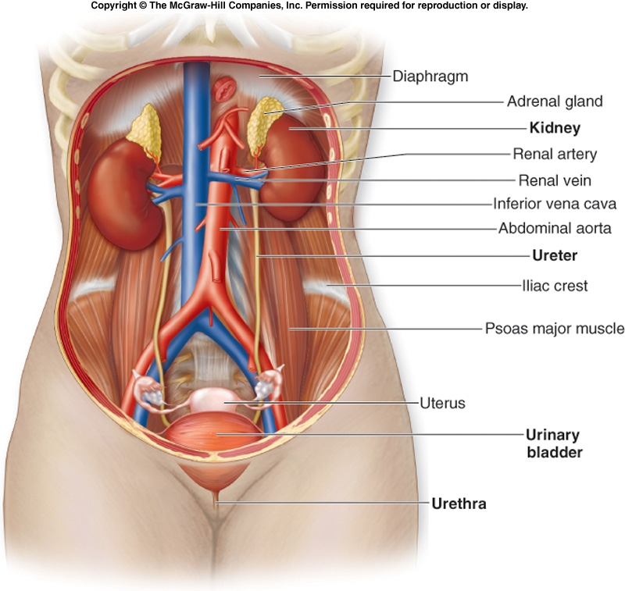

Slide 4
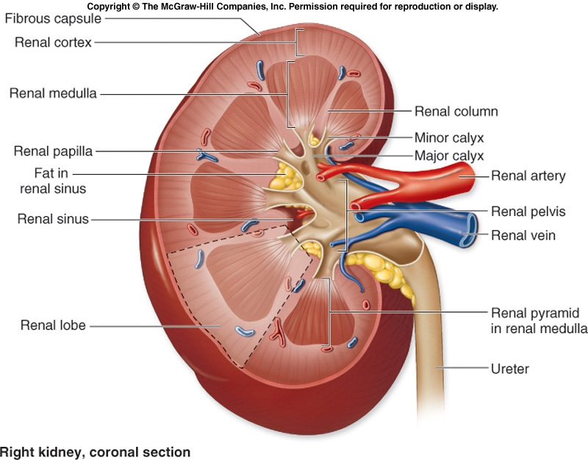

Slide 5
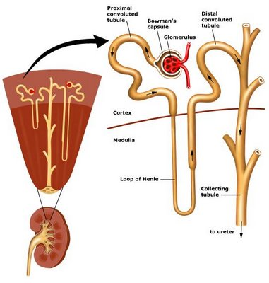

Slide 6
Kidney functions
Function:
1. Excrete waste products of
metabolism
2. Regulate body water
composition (osmolality)
3. Regulate body electrolyte
composition
4. Regulate blood pressure
(water volume)
5. Regulate acid
base balance
6. RBC production
7. Vitamin D production

Slide 7
Kidney disease
Loss of function…
…leads to:
1. Excrete waste products of
Uraemia
metabolism
2. Regulate body water
Electrolyte disturbances
composition (osmolality)
3. Regulate body electrolyte
Body fluid imbalances
composition
4. Regulate blood pressure
Uncontrolled hypertension
(water volume)
5. Regulate acid
base balance
Metabolic acidosis
6. RBC production
Anaemia
7. Vitamin D production
Hypocalcaemia &/or bone
disease

Slide 8
What is DKD?

Slide 9

Currently in NZ…
7% Diabetes
1.8% Undiagnosed
18.6% Pre-Diabetes
28%
(Copell et al., 2013)
Notes:
(NZ Medical Journal study …. Mann, Coppell et al)
Research published in March of this year that involved a sample of nearly 4.5 thousand Nzer’s found that 7% of those people already had diagnosed diabetes, but there was another nearly 2% whose blood test showed they had diabetes but they hadn’t been aware they had it.
As well as this….
a further 18.6% of people were found to have a condition called pre-diabetes.
This means that they didn’t actually have T2 diabetes YET, but a blood tests showed that their bodies were struggling to process the glucose in their blood adequately and if these people do not make some changes to their diet and increase their activity, they will go on to develop T2 diabetes.

Slide 10
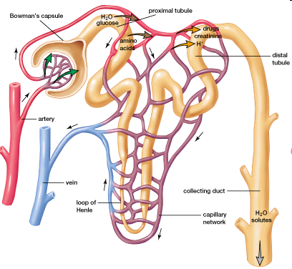

Slide 11
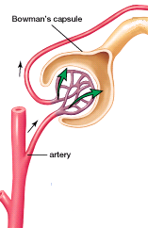
Glomerulus

Slide 12
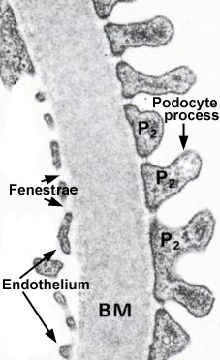
Glomerular membrane -
3 layers:
Endothelium
Basement membrane (BM)
Epithelium
Notes:
Glomerular Filtration
The capillaries within the glomerulus are porous and filter large quantities of water and solutes from the blood. The walls of the glomerular capiliiaries are composed of three layers:
Endothelium – this is the layer which lines the inside of the capilliary. It has large fenestrations (transcellular holes) which allow free filtration of substances up to a size of 100 nm. (albumin ~ 3.8nm, RBC ~ 7000nm). In addition to this size barrier, the surface has a negative charge which repels other negatively charged molecules (such as proteins).
Glomerular Basement membrane – made of fibrous proteins (eg collagen, fibrin) which form a mesh. The crossed fibres vreate a size barrier to prevent passage of large molecules. The layer also is negative charge and reples other negatively charged ions.
Epithelium – podocytes are attached directly to the GBM. They form close, narrow, elongated slit pores, which are about 25-60 nm wide. Also are negatively charged. These form the final barrier to molecule movement through the membrane.
Mesangial cells – located between capillary loops of glomerulus. They support capillary structures and have some phagocytic functions.
Thus the membrane filters selectively, based on size, charge, and protein binding. Small molecules (MW < 5000 da) are freely filtered – eg water, most electrolytes, amino acids, glucose.
Medium sized molecules are hindered, eg myoglobin 17,000 da
Large molecules eg plasma proteins 70,000 da, stay in blood

Slide 13
Advanced Glycosylated End-products
Glucose + protein = AGE
AGEs deposit in endothelium
Glomerular sclerosis
Notes:
Pathophysiology
Advanced glycosylated end products (AGEs) – glucose reacts with proteins in blood and forms collagen-like complexes (AGEs), which are deposited in the endothelium of small blood vessels
Endothelium thickens, loses its permeability to nitric oxide[1] and becomes subject to increased platelet and leukocyte adhesion
As this adhesive layer thickens, transport pores in vessel wall become stiff and open, leading to leakage of serum proteins from the vasculature
In the glomerulus, as the endothelial lining progressively thickens, albumin leaks into tubule → microalbuminuria
AGEs are filtered at glomerulus, so as GFR reduces, AGE deposition increases
[1] Nitrous oxide – aka ‘endothelium-derived relaxing factor’ - is manufactured in the endothelium and signals smooth muscle in vessel wall to relax, producing vasodilatation

Slide 14
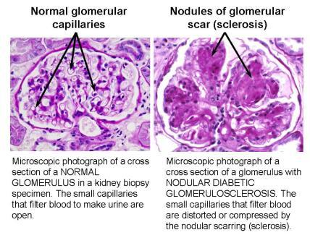

Slide 15
Albuminuria
Leakage of protein through glomerular membrane from blood into urine
Early marker of kidney disease
Predicts risk of progression of renal disease
Predicts cardiovascular risk
Reduction of albuminuria protects kidneys from damage

Slide 16
Assessment of kidney function
eGFR – estimated Glomerular Filtration Rate
normal = 100 - 125 ml/min
  i.e. 100 - 125 mls of blood is cleared of
  creatinine every minute

Slide 17
5 stages of CKD
Stage | Description | eGFR (ml/min/1.73m²)
1 | Kidney damage with normal or increased GFR | >=90
2 | Kidney damage with mild GFR fall | 60-89
3 | Moderate fall in GFR | 45-59 30-44
4 | Severe fall in GFR | 15-29
5 | Established renal failure | <15 or dialysis
(Johnson, 2011)
Notes:
Up until 2002, kidney disease was classified by its cause, such as glomerulonephritis or diabetic nephropathy. While this was useful for describing the underlying pathology, it was not helpful in describing the extent of disease, or the severity of its manifestations.
In 2002 NKF published this classification system for CKD, known as the KDOQI classification system. This system defined 5 stages of kidney disease, based on measurement of kidney function using eGFR.
This new classification system enabled the subsequent development of guidelines for best practice at the different stages of kidney disease. And most importantly for this discussion, it meant that patients at risk of developing later stages of CKD can be identified and treated early.

Slide 18
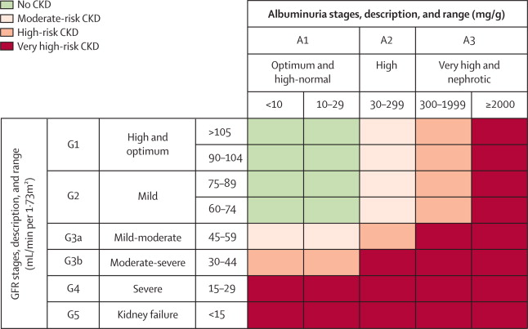

Slide 19
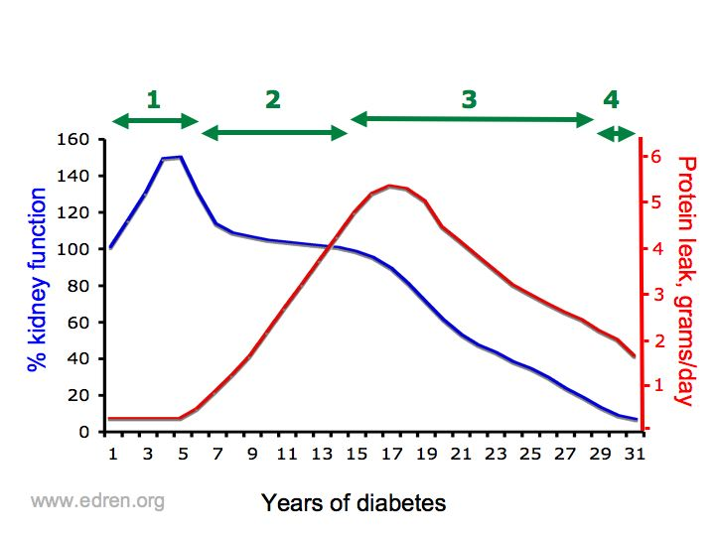
Progression of DKD

Slide 20
Progression of DKD
Symptoms of kidney failure

Slide 21
Why is DKD a problem?

Slide 22
Diabetic kidney disease is common, harmful, and costly
Notes:
Kidney disease is a common complication of diabetes

Slide 23
DKD is common
Half of people with T2DM have signs of kidney disease (~34,000)
50% of Māori,
49% of Pacific people,
31% of Asian,
28% of European
Kenealy et al., 2012
Notes:
Kidney disease is one of the microvascular complications of diabetes, caused by damage to the endothelium of the tiny blood vessels.
In 2012 Kenealy’s research group in Auckland looked for signs of kidney damage in 67,171 New Zealand adults with diabetes in primary care and concluded that on average, around half of all people diagnosed with T2DM in New Zealand have signs of kidney disease. When broken down into ethnicity, that study found significant disparities. (Kenealy et al., 2012).
These estimates are likely to be conservative, since they did not include the approximately 19% of the NZ population with undiagnosed diabetes and prediabetes who are likely to represent a significant number of people with unrecognised kidney disease (Coppell et al., 2013).

Slide 24
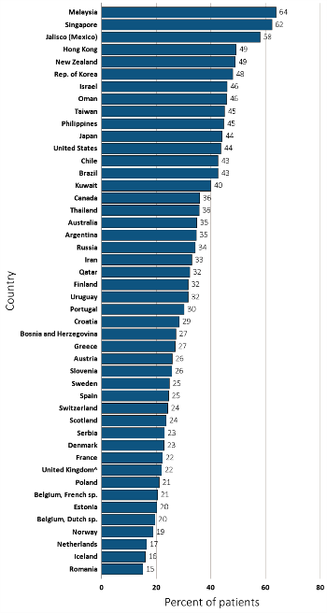
Figure 13.4 Percentage of incident ESRD patients with diabetes as the primary ESRD cause,
^{by country, 2013}
Data Source: Special analyses, USRDS ESRD Database. Data presented only for countries from which relevant information was available. ^United Kingdom: England, Wales, Northern Ireland (Scotland data reported separately). Data for Spain include 18 of 19 regions. Data for France include 22 regions. Data for Indonesia represent the West Java region. Data for Belgium do not include patients younger than 20. Abbreviations: ESRD, end-stage renal disease; sp., speaking.

Slide 25
48%
16%

Slide 27
DKD is harmful
Independent risk factor for CVD
10 times higher risk of CVD (Adler et al., 2003)
Higher rates of mortality before and after renal replacement therapy (Mailloux, 2014)
Poorer quality of life on dialysis
4th greatest disease in terms of health loss (Ministry of Health, 2013)
3rd most common cause of death (White & Chadban, 2014)
Notes:
Diabetic kidney disease is harmful. Kidney disease and diabetes each infer an independent and incremental risk factor for death from CVD.
A re-examination of data from the landmark UKPDS research suggested that people with T2DM, who develop kidney disease, were more likely to die from CVD than progress to dialysis (Adler et al., 2003).
A prospective cohort study of nearly 28,000 patients enrolled in a large primary health organisation in Oregon, found that among people with diabetes, those with kidney disease had over 10 times the risk of CVD than those without kidney disease (Keith, Nichols, Gullion, Brown, & Smith, 2004).
Mortality and morbidity on dialysis are high; rates of up to 80% mortaslity after five years have been reported (Mailloux & Henrich, 2014). Comorbidities and the burden of treatment have been shown to contribute to reported poor quality of life and increased hospitalisation in dialysis patients with diabetes
A recent New Zealand Ministry of Health report places CKD at fourth place in terms of total health loss (Ministry of Health, 2013). This estimate takes into account the years of life lost through early death, the years lived with disability, and additional burden on health due to risk factors for other disease.
Data recording the actual cause of death in diabetes-related mortality are not reported in New Zealand, but Australian data shows that in 2007 kidney disease was the third most common cause of death in people with diabetes, after coronary artery disease and hypertensive diseases (White & Chadban, 2014).

Slide 28

DKD is costly
$33,000 - $64,000 per patient per year for dialysis (Ashton & Marshall, 2007)
$36 million spent on end stage DKD (Endre et al., 2006)
30-50% higher costs with diabetes-related end stage kidney disease (USRDS, 2013)
Notes:
The economic cost of DKD in its early stages preceding dialysis is not well studied. Most research into the costs of KD in general includes the financial cost of RRT, and does not identify the pre-dialysis costs.
Data from Counties Manukau District Health Board (CMDHB) in 2004 showed the average annual cost of dialysis treatment per patient ranged between $33,585 for home haemodialysis, and $64,318 for hospital haemodialysis, accounting for 1% of the total health budget (Ashton & Marshall, 2007; National Renal Advisory Board, 2006).
Another New Zealand study in 2006 estimated that NZ$90 million per annum was spent on RRT, with NZ$36 million spent on diabetic ESKD alone (Endre, Beaven, & Buttimore, 2006).
Data from the United States shows that costs associated with diabetes-related ESKD are 30% to 50% higher than those related to other causes of kidney disease (United States Renal Data System, 2013).

Slide 29
“The health and economic burden of diabetic nephropathy is so great that even costly interventions will continue to be worth exploring to protect our patients from the consequences of this devastating condition.”
(Rippin et al., 2004, p.23)
Notes:
Considering all of this evidence, it is reasonable to assume that any significant reduction in the rate of progress to kidney failure which translates to extending the pre-dialysis stages of DKD will have major economic benefits.

Slide 30
What can we do about it?

Slide 31
Diabetic kidney disease is preventable and treatable if detected early

Slide 32
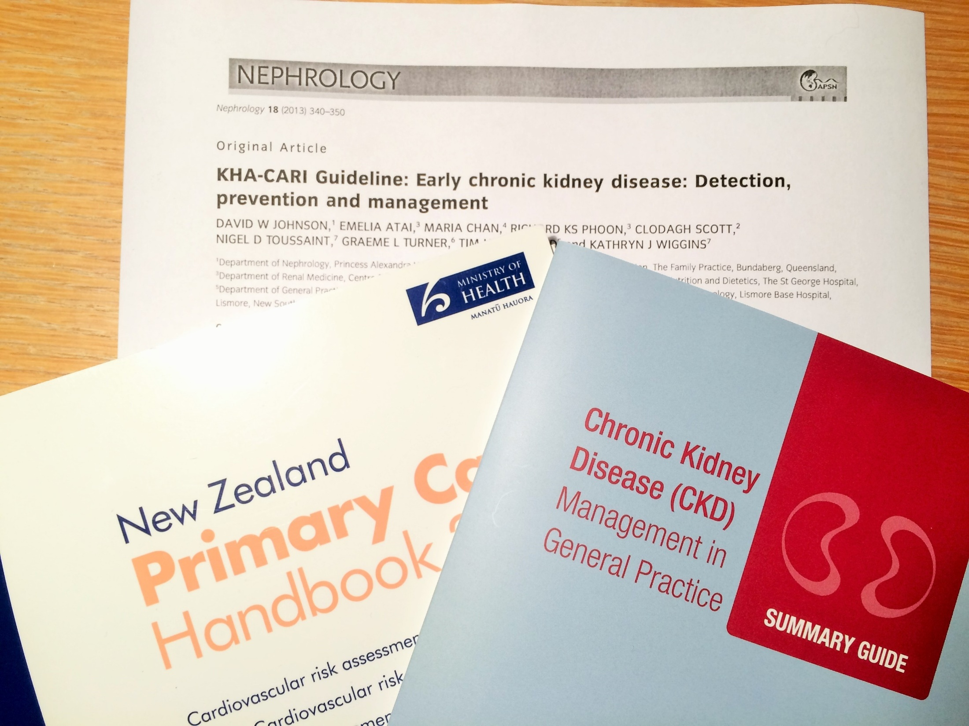
Notes:
International best practice guidelines for early detection and management of DKD are well established (since 2002).
In Australasia, we have the CARI guidelines written specifically for the New Zealand context, and these have been distilled into useful tools for applying these evidence based recommendations in clinical practice.

Slide 33
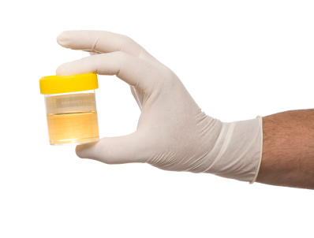

Preventable and treatable
Screening those at risk
  ACR, eGFR, blood pressure
Modify risk factors
  Hypertension
  Albuminuria
(KDIGO, 2013)
Notes:
Research has shown that early detection of albuminuria and hypertension, and their aggressive treatment can reduce, halt, and even reverse the progression of kidney disease, particularly in high risk diabetic populations (Eknoyan et al., 2004; MacIsaac et al., 2010; J. Turner, Bauer, Abramowitz, Melamed, & Hostetter, 2012).
Early identification is an important and effective strategy to reduce the increasing burden of CKD. Screening should be targeted at those who are at high risk for kidney disease, and this of course includes those with diabetes.
Screening should include a urine ACR for albuminuria, a blood test for serum creatinine to estimate glomerular filtration rate, and blood pressure measurement. Serum creatinine is an insensitive marker for detecting mild to moderate kidney disease – eGFR is the preferred test.
Early intervention by modification of risk factors (in particular hypertension and albuminuria) in patients with diabetes has been shown to slow the progression of DKD, thereby prolonging the length of time until commencement of RRT (Chadban et al., 2010; Dreyer et al., 2013; Levin, 2005; Levin & Stevens, 2011; Saweirs & Goddard, 2007).
Furthermore, the benefits of early treatment continue after RRT has begun, with fewer adverse outcomes at the time dialysis starts, and reduced morbidity and mortality later in RRT programmes (S. Chen et al., 2010; Hasegawa et al., 2009; Levin & Stevens, 2011).

Slide 34
Currently in NZ…
7% Diabetes
1.8% Undiagnosed
18.6% Pre-Diabetes
(Copell et al., 2013)
Notes:
(NZ Medical Journal study …. Mann, Coppell et al)
Research published in March of this year that involved a sample of nearly 4.5 thousand Nzer’s found that 7% of those people already had diagnosed diabetes, but there was another nearly 2% whose blood test showed they had diabetes but they hadn’t been aware they had it.
As well as this….
a further 18.6% of people were found to have a condition called pre-diabetes.
This means that they didn’t actually have T2 diabetes YET, but a blood tests showed that their bodies were struggling to process the glucose in their blood adequately and if these people do not make some changes to their diet and increase their activity, they will go on to develop T2 diabetes.

Slide 35
How?
Target BP < 130/80 mm Hg
Target 50% reduction in urine ACR
ACE or ARB even if no hypertension
Target HbA1c 50 – 55 mmol/mol
Target total cholesterol <4.0, LDL < 2.0, HDL >1.0 , Triglycerides <1.7

Slide 36

https://thinkgp.com.au/kha

Slide 37


Slide 38
Diabetic kidney disease is preventable, common, harmful, and treatable if detected early

Slide 39
References
Adler, A., Stevens, R., Manley, S., Bilous, R., Cull, C., & Holman, R. (2003). Development and progression of nephropathy in type 2 diabetes: The United Kingdom Prospective Diabetes Study (UKPDS 64). Kidney International, 63(1), 225-232.
ANZDATA Registry. (2015). 37th Report, Chapter 1: Incidence of End Stage Kidney Disease. Australia and New Zealand Dialysis and Transplant Registry, Adelaide, Australia. Available at: http://www.anzdata.org.
ANZDATA Registry. (1978). 1st Report. Australia and New Zealand Dialysis and Transplant Registry, Adelaide, Australia. Available at: http://www.anzdata.org.
Ashton, T., & Marshall, M. (2007). The organization and financing of dialysis and kidney transplantation services in New Zealand. International Journal of Health Care Finance and Economics, 7(4), 233-252.
Coppell, K. J., Mann, J. I., Williams, S. M., Jo, E., Drury, P. L., Miller, J., & Parnell, W. R. (2013). Prevalence of diagnosed and undiagnosed diabetes and prediabetes in New Zealand: Findings from the 2008/09 adult nutrition survey. New Zealand Medical Journal, 126(1370).
Eknoyan, G. (2003). Meeting the challenges of the new K/DOQI guidelines. American Journal of Kidney Diseases, 41(5 Suppl), 3-10. Endre, Z. H., Beaven, D., & Buttimore, A. (2006). Preventable kidney failure: The cost of diabetes neglect? New Zealand Medical Journal, 119(1246).
Kenealy, T., Elley, C. R., Collins, J. F., Moyes, S. A., Metcalf, P. A., & Drury, P. L. (2012). Increased prevalence of albuminuria among non-European peoples with type 2 diabetes. Nephrology Dialysis Transplantation, 27(5), 1840-1846. doi: 10.1093/ndt/gfr540
Kidney Disease: Improving Global Outcomes (KDIGO) CKD Work Group. (2013). KDIGO 2012 Clinical Practice Guideline for the Evaluation and Management of Chronic Kidney Disease. Kidney international Suppl., 3, 1-150.
Mailloux, L., & Henrich, W. (2014). Patient survival and maintenance dialysis J. S. Berns (Ed.) UpToDate. Retrieved from http://www.uptodate.com/contents/patient-survival-and-maintenance-dialysis
Ministry of Health (2013a). Annual Update of Key Results 2013/14: New Zealand Health Survey. Wellington: Ministry of Health.
Ministry of Health. (2013b). Health Loss in New Zealand: A report from the New Zealand Burden of Diseases, Injuries and Risk Factors Study, 2006-2016. Wellington: Ministry of Health.
New Zealand Guidelines Group. (2012). New Zealand primary care handbook 2012. Retrieved from http://nzgg.org.nz/library_resources/92_primary_care_handbook
Rippin, J., Barnett, A., & Bain, S. (2004). Cost-effective strategies in the prevention of diabetic nephropathy. PharmacoEconomics, 22(1), 9-28.
Thomas, M. C., Weekes, A. J., Broadley, O. J., Cooper, M. E., & Mathew, T. H. (2006). The burden of chronic kidney disease in Australian patients with type 2 diabetes (the NEFRON study). The Medical journal of Australia, 185(3), 140-144.
United States Renal Data System. (2013). USRDS 2013 Annual Data Report: Atlas of Chronic Kidney Disease and End-Stage Renal Disease in the United States. Bethesda, MD: National Institute of Diabetes and Digestive and Kidney Diseases. Retrieved from http://www.usrds.org/atlas.aspx
Wagner, E., Austin, B., & Von Korff, M. (1996). Organizing care for patients with chronic illness. The Milbank Quarterly, 74(4), 511-544. doi: 10.2307/3350391
White, S., & Chadban, S. (2014). Diabetic kidney disease in Australia: Current burden and future projections. Nephrology, 19(8), 450-458.

