Slide 1


Lower North Island Managed Clinical Network Jazz Heer (Network Manager, MCN) Sue Lodge (Nursing Clinical Lead and Pall Care Nurse) Robyn McArthur (Medical Clinical Lead and GP)
Notes:
Introduction about the Lower North Island MCN and the project – the journey and commitment from network
A collaborative network with the primary purpose to build greater system integration for palliative care
that puts the patient and their whanau at the core of every decision that is made – not systems.
Flipped things around - patient facing not provider
Strategy: Develop a framework to engage more broadly with our colleagues and stakeholders to help inform the change that is needed
Vision for MCN – governance/workforce and Model of Care

Slide 2
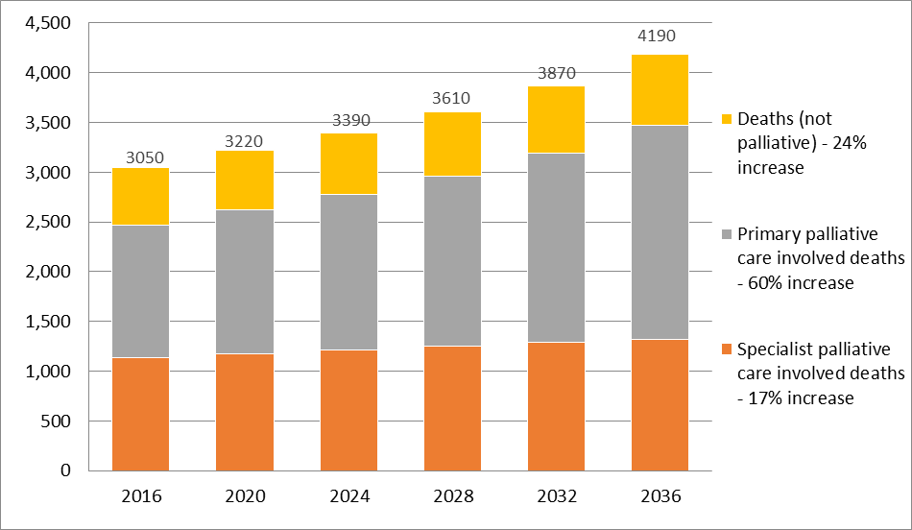
Challenges for our system
Next couple of decades there will be dramatic changes in the patterns of life, disease, dying and death
Projected demand for our sub-region:
Source of projective data: Heather McLeod (2016)
Notes:
More people will be dying each year – actual numbers will go up
People will be dying at older ages and with more chronic conditions and frailty
30% are likely to be in Aged Care Facilities
Please note: Palliative primary care refers to those whose work is not delivering substantive palliative care i.e. it is a component of their service which might have a broad health focus or specialty medicine, i.e. General practice teams, Maori and Pacific health providers, allied health teams, DNs, residential care staff, ward staff as well as disease specific teams i.e. oncology, respiratory, renal and cardiac teams.
Everything that is NOT specialist
First Challenge - Recognised that current system and models of care are ill equipped to provide a sustainable service to deal with future demand

Slide 3
What we heard
Access to services is variable across the 3 districts
The system is fragmented with no clear defined pathways (Wellington and Hutt Valley);
The quality of care is variable across different settings and across the 3 districts - there are gaps in the capability of the palliative care workforce;
There is a focus on services and providers rather than a focus on the patient and their whānau;
Information systems are not well connected.
What matters to patients and their whānau is to be with their loved ones, symptom control, good communication and well coordinated care.
Notes:
Second challenge is that our current system and models are not working as well as they could.
Mention vulnerable groups - cultural groups/disabled communities/prison communities

Slide 4
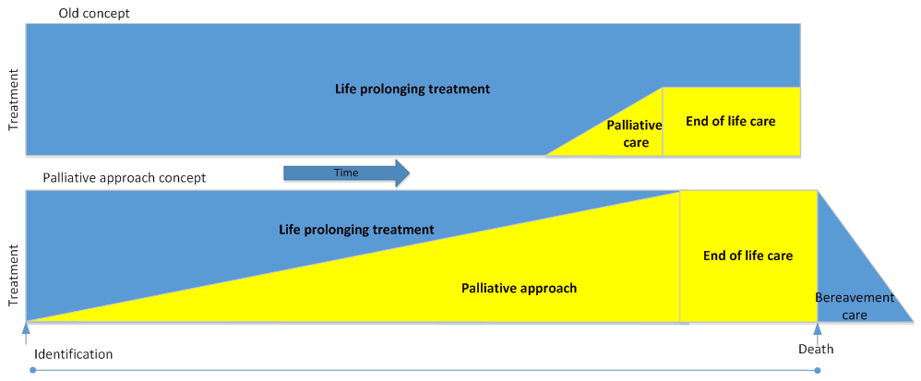
A shift is needed...
Notes:
Vision:
All people who require a palliative approach live well and die well irrespective of their condition or care setting
Need to change our model as well as our approach
Principles:
Patient and their families/whānau are at the centre of all care
Patients and family/whānau can expect and receive high quality care wherever they may be
Patients and family/whānau will be supported so they can die well

Slide 5
Palliative Care Patient Journey
Notes:
Filling the gaps so the transitions between services are smooth – patients experience seamless care

Slide 6

We now believe palliative care not to be what it could be
It should have been a moment of grace at the end... 1 ½ years on our family is still fractured
No-one knew what was going on- and if they did, they didn't communicate this to us
Nobody tells you what is available
If we just had one person delivering care we wouldn’t have gone through what we did
Early information about what to expect would have been more helpful
My wife and I were in control – we just needed you to support us
Everything we needed was there when we needed it - nothing was too much
I’m dying and I want to go home
Those who end up having to be in residential care deserve to have just as much care taken of them as anyone else
The system would work a lot better if everyone worked as a team
Notes:
Quotes from engagement with consumers/whānau

Slide 7
Strategic Goals
1. Self Management
2.Planning
3. Integration
4. Quality
5. Last days of Life
6. After Death Support

Slide 8
1. Self management
Patients and their whānau have early discussions as end of life approaches to ensure they make early informed choices about the what, where and how of care and support they receive
Notes:
Information
Early involvement of a palliative approach
Early identification and discussions
Important that people are told they have a life limiting illness and conversations begin
Research about early referrals to palliative care
Give patient example for each goal

Slide 9
2. Planning
Patients and their whānau receive coordinated assessment, care planning and review throughout their illness
Notes:
Coordinated Assessment and Care Planning – a plan that follows the patient
Palliative care pathway to support service transitions and transfers
Use examples – no planning

Slide 10
3. Integration
Patients and their whānau experience equitable and seamless care through coordinated service provision
Notes:
Future model of care -one integrated palliative care system in each District formalised ways of working
Single point of service facilitation
Technology support to enable shared care plans – that is the patients plan that those that need to see it can

Slide 11
4. Quality
Patients and their whānau experience high quality services in different settings
Notes:
Build capability and capacity of workforce (Workforce planning and Training/professional development)
Clinical networks/service level alliances
Quality framework
Patient/whānau voice
ARC facility equipped to care

Slide 12
5. Last days of Life
6.After Death Support
Care in the last days of life is comprehensive, with good symptom control, is in the most appropriate setting in the company of whānau and/or friends
Whānau experience high quality care after death
Notes:
Availability of comprehensive and responsive range of services, to wrap-around patients/whanau as end of life approaches to enable a ‘good death’ and continuing into bereavement.

Slide 13
Next steps…. Implementing the Strategy
Achieving future vision will involve a period of evolutionary change
Prioritisation of actions and opportunities for service improvements, based on the Strategy will be identified locally and overseen by the respective Alliance Leadership Teams in each DHB.
Notes:
Despite the gaps and barriers there are some pockets of effective integration and partnership working in each district - implementation will build and expand on these towards further integration and enhanced coordination
Patients and their family don’t know who is delivering care – they just need to know its coming and it will be good quality care
Some actions will be undertaken sub-regionally but others will be at a local level - based on what is currently available for patients and whanau.

Slide 14
Work already underway
3DHB actions are already underway with MCN Projects Workforce Planning and Training & Professional Development Plan($60k) – March 2017
New projects to develop community focused palliative care services (Hospice Initiatives Funding announced in Budget 2015) which include $225k one off funding and $700k per annum ongoing funding.
Notes:
Work is already underway with:
i) Implementation of the identification and anticipatory care planning for patients with palliative care needs in primary care have just been launched in HVDHB and CCDHB, and additional post death support and the Voices survey are soon to be introduced across the sub-region. These are funded via the new Hospice Initiatives Funding which includes one-off funding ($225k) as well as ongoing funding ($700k per annum across the sub region) for new community focused palliative care services in the sub-region announced in the Budget 2015.
ii) The development of a sub-regional workforce plan and development of a training/professional development programme are now underway as Palliative Care Managed Clinical Network projects and funded ($60k) within the pool of funds from the HWNZ contract.
iii) As the funding the sub region had to support the Network is ending in March 2017 and that it is proposed that the local Alliance Leadership Teams will take responsibility for implementing further actions of the Strategy.

