Slide 1
Palliative Care Initiative Funding

Slide 2
2015 Budget – New Palliative Care Funding
Funds go to hospices
- Mary Potter Hospice
- Te Omanga Hospice
  - Wairarapa DHB & Hospice Wairarapa
Benefits to be shared with patients and families in aged residential care
- Hence the focus on partnerships
- Hence the focus on innovation and new services

Slide 3
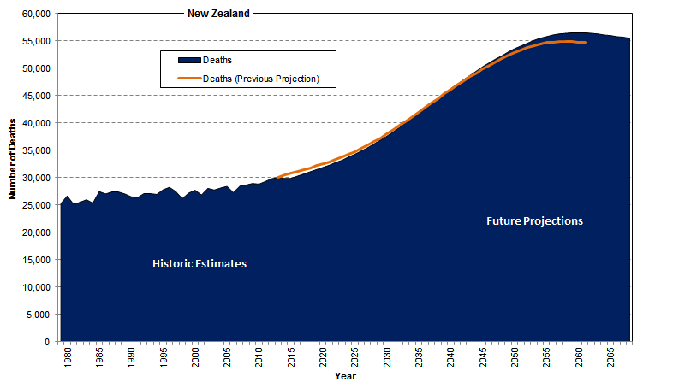
Historic Deaths and Future Projections - Comparison

Slide 4
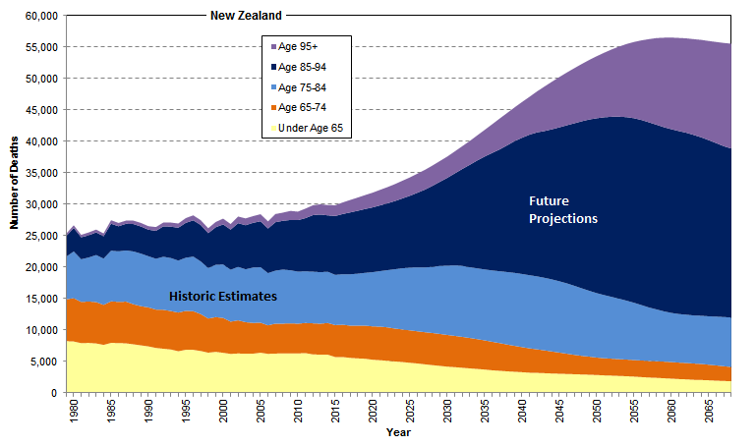
Historic Deaths, Future Projections
Updated projections from Statistics NZ use Base 2014 and project to 2068. Graph begins in 1979 when the first hospice was opened in New Zealand. Note the increase in deaths over age 85-94 and age 95+.
Source: Drawn using data from Statistics New Zealand. Historic estimates and National population projections, 2014(base)-2068

Slide 5

PALLIATIVE CARE INITIATIVE FUNDING
Extended Hours
{Weekend/Evenings}
Pasifika Liaison
ARC & Primary Care Partnership
{Nurses & SW}
Link Nurse Program
{ARC/Primary Care}
Psycho-social support
{Bereavement Clinics}
Anticipatory Care Planning
{Primary Care}
Family/Volunteer/HCA Training
Voices Survey {National}
Education
Development
Maori Model of Care

Slide 6
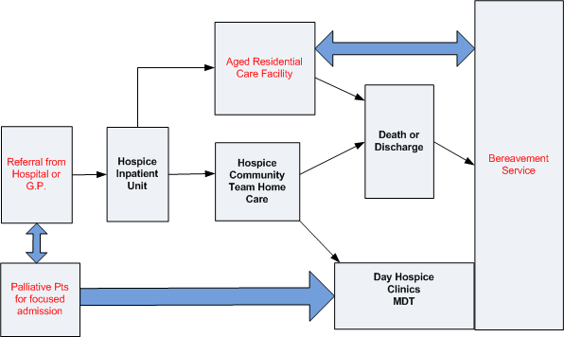
New Services Pathway

Slide 7
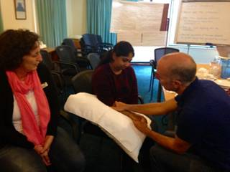
Thought from the day: “It is so great to know that we are not alone in finding end of life care conversations challenging”
Picture from the day: “ LINK” Pat working with Neenu and Mandy demonstrating therapeutic hand massage

