Slide 1
Nurses: A voice for the vulnerable
Midlands NZNO Professional Forum June 2017

Slide 2
I am a nurse
What do you tell people about what you do as a nurse?
How do you promote nursing as a profession to others?
What are the things you hear people saying about nurses?
What keeps you practising as a nurse?

Slide 3
I’m ‘Just a nurse’
I just make the difference between life and death
I just have the educated eyes that prevent medical errors, injuries and other catastrophes
I just educate patients and families about how to maintain their health
I just make the difference between a person staying in their own home and going to a nursing home
I just make the difference between dying in agony and dying in comfort and with dignity
I’m just central to providing the real bottom-line in health care
Suzanne Gordon 2001

Slide 4
As nurses we:
Care for the whole person – compassion, empathy
Required to provide non-judgmental care
Develop therapeutic relationships that enable us to work in negotiated partnerships with patients and whanau to assess, plan, deliver and evaluate care
Undertake comprehensive nursing assessments that include social/ family, spiritual, mental / emotional and physical wellbeing
Provide health information in a manner that improves health literacy and enables patients to self-manage their health
Can make a difference to health outcomes, inequities and health disparities for Māori and other vulnerable populations
Advocate on behalf of others

Slide 5
Being an advocate
Nurses play an important role as an advocate, we speak up or put forward a case on someone else’ behalf
In pairs share how you have advocated for:
Patients, whanau/families, communities
Nursing colleagues
The circumstances in which you have had to be an advocate

Slide 6
Nurses: A voice for the vulnerable
Levels of advocacy
Patient care- meeting patient needs
Access to services / treatment
Organisation level - policies responsive to patient needs, health care outcomes
Regional level – access to services
National level – funding, policies

Slide 7
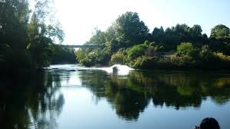
Population of Waikato DHB Region
60% of population lives outside the main urban areas
More rural than NZ as a whole
Aging population
Growing Maori population 23 %
Higher percentage live in areas of low socio-economic status than rest of NZ
Increase in people with chronic illnesses

Slide 8
Who are the vulnerable people who access your services?

Slide 9
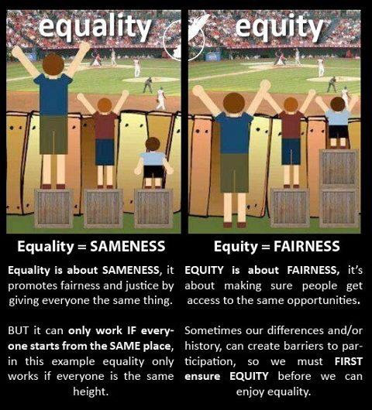
Equality and Equity
Health inequities create additional barriers to accessing health care in a timely way.
These are differences in health which are unfair, avoidable and remedial.
= fixable

Slide 10
A workforce to meet needs of culturally diverse population
Culture is one of many social determinants of health which includes housing, employment, education and poverty. Culture has a significant impact on the health of indigenous people:
….because culture influences behaviours through customs, traditions, beliefs and values.
(Jansen & Jansen, 2011, p.54).
Clients’ cultures affect the ways they understand health and illness, how they access health services, and how they respond to health care interventions.

Slide 11
Ethnicity of nursing workforce
57% New Zealand European
14% Other European
6% Maori
6% Filipino
5% Indian
3% Pacific
11% Identify multiple ethnicities
(Nursing Council Workforce Statistics, 2015)

Slide 12
Cultural Competence
Cultural competence places an emphasis on the health practitioner-patient relationship that requires the practitioner to have an understanding of different worldviews to health and wellbeing, and the role of family and community in the health experience. Focus is on therapeutic relationships to improve health outcomes.
(Durie, 2001)

Slide 13
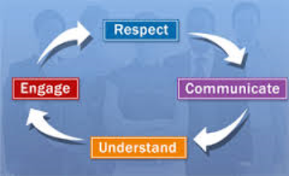
Cultural Safety
“Cultural safety should be the experience of all recipients of nursing care. It is about protecting people from nurses, from our culture as health professionals, our attitudes, our power and how we manage these things whether unintentionally or otherwise”
(Ramsden, 2000, p.4)

Slide 14
How well prepared do you feel to meet the needs of culturally diverse population?
What are some of the challenges you have experienced caring for culturally diverse population?
What education have you accessed to support you to meet the holistic needs of clients who access your services?

Slide 15
A workforce to reflect the population
MOH has set goal to have a nursing workforce that reflects the population by 2028
Māori represent 23% of the Waikato DHB region population
Māori nurses represent 7% of the Waikato DHB nursing workforce

Slide 16
Why?
Maori over-represented in poor health outcomes
To more appropriately meet the needs and expectations of Māori
Benefits of by-Māori-for-Māori – care based on Māori models, integration of Māori values into care, have focus on whanau, hapu, iwi
Have the passion and heart to improve health access and outcomes for Māori
Work from a strengths based rather than a deficit based approach
Focus on holistic health and wellbeing rather than disease & treatment

Slide 17
Developing the Māori nursing workforce
Māori have much higher expectations of Māori health professionals, they expect us to get it right
Māori experience the poorest health and need knowledgeable and skilled nurses to meet their complex needs
Most Māori nurses complete their nursing training in mainstream programmes using western models
Workforce development assists Maori nurses to explore their practice from a Maori worldview, utilise Maori nursing practice models, and apply

Slide 18
As Māori nurses we:
Bridging two worlds | Going beyond | Practicing differently
Advocating for Māori | Extending practice beyond that expected of other RNs | Blending the world of Māori with world of nursing
Defending Māori customary practices | Being Māori and enduring constant challenge of living and working in two worlds | Guardians of spiritual wellbeing underpinned
Interpreting the movement between the two worlds for their patients and families | Cultural identity was source of commitment to improving Māori health outcomes | Obligation to ensure customary cultural practices occurred
Personal and professional cultural identities at odds, contributing to tension | Cultural identity enabled Māori nurses to connect and relate to patients and their families | Support for whanau cultural identity, collective responsibility
 | Motivated to manage and adapt to situations of conflict and tension by need to provide improved health care for Māori | Facilitating processes for culturally appropriate engagement, use of Māori language and rituals
Notes:
Wilson & Baker (2012) Bridging two worlds: Māori mental health nursing
This Māori nursing practice model highlights some of the tensions that may exist for Māori nurses working in mainstream organisations as they advocate and defend Māori customary practices, bridge two worlds and practice differently to other nurses. Many new graduates and other Māori nurses have found this model validates the way they practice when caring for Māori.

Slide 19
Te Kapunga Putohe (The Restless Hands) A Māori centred nursing practice model
Taha Maui (left hand) – Nursing Practice | Taha katau (right hand) – Māori Practice
Tikanga (rule, plan) – professional obligations and responsibilities | Whanaungatanga (all things related to family, connections) – acknowledge whakapapa, whanau, hapu and iwi
Pono (true, genuine) - trustworthiness and honesty | Wairuatanga (spirituality) – karakia, traditional beliefs, restore wairua of person and whanau
Aroha (compassion) – compassion, mutual respect and trust | Oranga (wellbeing) – holistic view of health with balance in all dimensions
Manaakitanga (show respect and kindness, hospitality) – empathy and respect | Mana Tangata (personal authority, power) – person’s power from within, acknowledge individual as part of whanau collective
Tiakitanga (to watch for) – be an advocate for Māori client and whanau | Tikanga Māori (Māori customs and practices) – enable Māori customs and practices within delivery of health services
Notes:
Barton & Wilson (2008)
This model was the result of Pipi Barton’s Masters Thesis. Pipi was working as a mental health nurse in Henry Rongomau Bennett Centre at the time she was undertaking her thesis. Although she designed this model for any nurse to use it has been a useful model for Māori graduates and nurses to reflect on their professional and cultural practice.

Slide 20
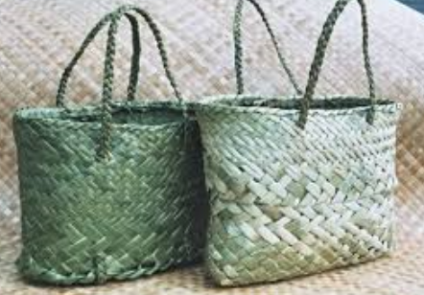
Naku te rourou nau te rourou ka ora ai te iwi
With your basket and my basket the people will live
(It requires co-operation and the combination of resources to get ahead)
Notes:
So while developing the Maori nursing workforce the development of other nurses to care appropriately for Maori is essential if together we are going to achieve ‘radical improvement in Maori health outcomes by eliminating health inequities for Maori’ (Waikato DHB Strategy, 2016)

